Slide 1








QC Benchmarker: a streamlined web application to comprehensively evaluate instrument performance and direct troubleshooting
I am not planning on using pics, but I did think it was a fun idea for a second.
Benjamin A. Neely
Paul E. Anderson
W. Clay Davis
Magnus Palmblad
Identification of certain commercial equipment, instruments, software or materials does not imply recommendation or endorsement by the National Institute of Standards and Technology, nor does it imply that the products identified are necessarily the best available for the purpose.
Notes:
Implications and opportunities of low-cost high-quality genome sequencing.

Slide 2



System Suitability – how you test is important
Metrics
Track speed
High-speed corners
Race Car
Track speed
Low-speed corners
High-speed corners
Braking
etc.
?
Modern Mass Spectrometer
Metrics
22k MS/MS
3552 PSMs
103 Peptide groups
77% coverage of BSA
BSA Digest
HeLa Digest
75k MS/MS
28,469 PSMs
21,689 Peptide groups
4140 Protein groups
Notes:
How do you know you your system is working properly before/during your analysis
Benchmarked relevant Sample – old days was BSA, now is HeLa
Key point, aside from obvious, is how you can run BSA on a poorly performing modern mass spec and get “good” values.
How do you evaluate?

Slide 3
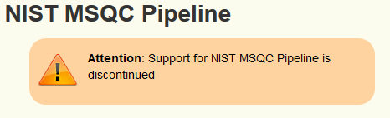
Quality control metrics
ID-free Metrics:
Peak width/shape
TIC
Mass error
Charge state distribution
…
etc.
ID-based Metrics:
Detection of specific peptides
Rates of peptide identification
Coverage of known proteins
Provided ID-free and ID-based metrics of the whole system
46 quality metrics related to chromatography, ion source, MS1 and MS2, as well as peptide identifications
Tools derived/inspired by MSQC:
MassQC
Metriculator
QuaMeter
Notes:
ID-free benefits
Eleminate any artifacts or variability associated with ID-process
Can retrieve metrics on any LC-MS/MS run, not just proteomics
2010 was MSQC
Metriculator was/is Prince Lab – a web version of MSQC
QuaMeter is the updated MSQC that can accept more formats but generates almost the same metrics
Metrics emphasize quartiles and log ratios to give robust behavior in extreme variation
spRoCoP - Statistical Process Control in Proteomics is basically LC

Slide 4




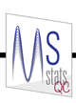
QC – the current toolset
ID-Free only
spRoCoP - Statistical Process Control in Proteomics
Raw Beans
QC-ART
Specific application QC tools
TMT - TVT: Triple Knockout Proteome Standard Visualization Tool
ID-Free + ID-based
Local and/or web-based versions
Can work on any lab’s QC sample
Some require the presence of predefined m/z
Can be used for quality controls within experimental runs
RawTools
QCQuan
PTXQC
QCMAP
pmartR
SIMPATIQCO Server
* this is not an exhaustive list, please excuse any omissions.

Slide 5
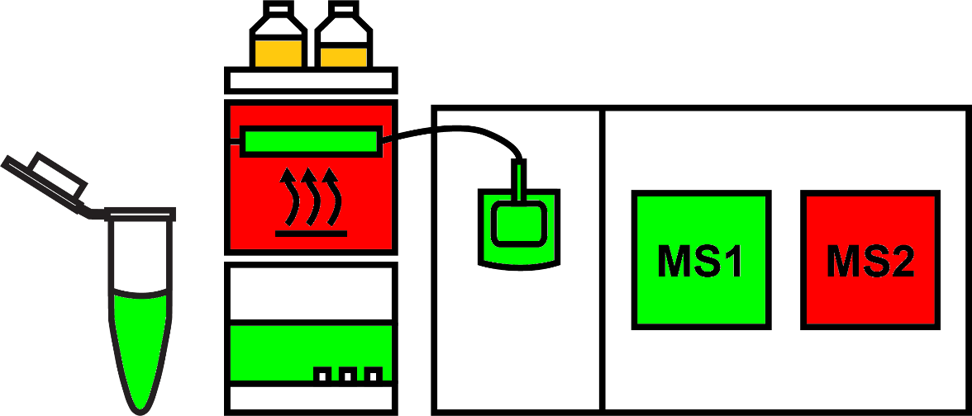
QC Benchmarker – Goals and Rationale
drag and drop to website
Commercial Digest
(HeLa, Yeast, E. coli)
raw
no parameters required
Use commercial digest standards and standard methods
Upload raw file to web-app
Return high-level summary (good, marginal, bad) with in-depth reports for troubleshooting
Change this graphic to more simplistic, or whatever we want to show here.
Notes:
That our goal was to improve system suitability testing/utilization and usefulness for troubleshooting
Is the sample deteriorated?
Is the LC performing as expected without interferences
Is the source spraying and ionizing?
Is the MS1 set correctly (mass error, AGC, etc.)

Slide 6
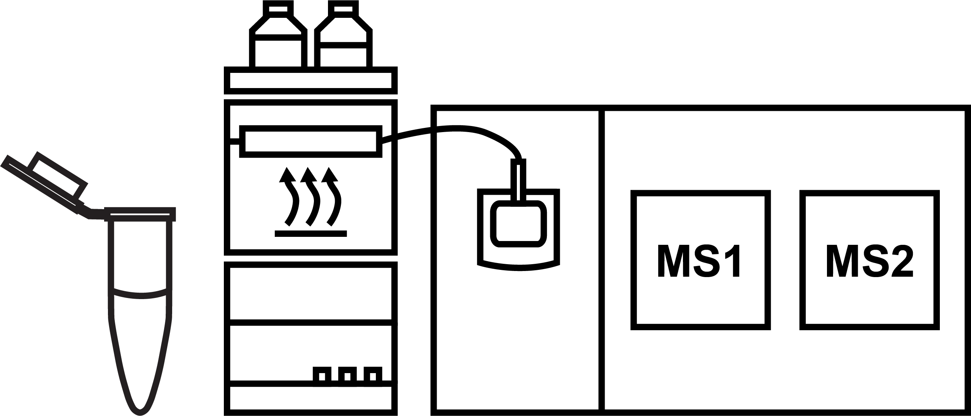

Yet another tool!!!
By specifically focusing on a weekly QC sample run for system suitability, all our metrics/reports can be made without user specified parameters.
?
Instead of plotting a predefined peptide or m/z across many datasets, we use machine learning to model the performance of the LC and the ion source, to give more actionable QC metrics for troubleshooting. We also strive to have one ID-based and one ID-free metric for each system component.
TIC
Peak Widths
PSMs
 | Sample | LC | Source | MS1 | MS2
ID-free | amount loaded on column | Peak-widths, peak capacity | stability | TIC | Frequency
ID-based | % spectra matched | pH of mobile phases |  | Mass error | Mass error; # PSMs
*there are more metrics than these
Notes:
I am going to go narrative here. I want to point out that my tech (which I don’t have one, but don’t tell) is in the lab and they just calibrated the instrument. Our SOP is to run a commercial digest on a predefined method. QC Benchmarker will allow them to drop the resulting raw file onto the website and get back high-level data. No input required.

Slide 7
Development of QC Benchmarker
Standard sample,
LC gradient,
and acquisition parameters
Very stable
Performance of source to MS2 is verified during calibration
Problems
Pumps, column, mobile phases, system contaminants, etc.
Notes:
“Standard” LC-MS/MS settings:
200 ng of HeLa
LC Gradient
Standard acquisition parameters (for Lumos and QE classic)
Generated ~70 runs specifically looking at:
Mobile phase pH (0.1% formic acid to no formic acid)
Different amounts of HeLa on column (50 to 1000 ng)
Sub-optimal collision energy
Attempted to degrade HeLa
Runs before and after MS cleaning
Attempted to decrease transfer efficiency
Mass error (couldn’t get over 8 ppm)
Running on a different platform (QE classic v Lumos)
15 runs across a year

Slide 8
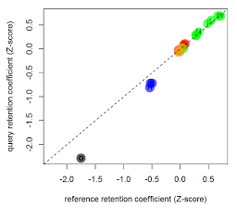
Machine Learning-based prediction of mobile phase pH and pump performance
Good
pH shift
A deviation away from the unison slope indicated mobile phase pH is off
A deviation of the lines intercept indicates the pumps aren’t performing correctly
Notes:
Peak widths good, but you can see global retention time shifts
If residues are linear, but shifted, the likely pumps

Slide 9
Autocorrelation-based peak width determination
Shifted all points by 50 ms

Slide 10
Autocorrelation-based peak width determination
30 second peak at base
FWHM = 11.7 sec
FWHM
Notes:
MSQC and QuaMeter emphasized quartiles for peak widths to give robust behavior in extreme variation. This is a similar mindset where we want to represent the whole gradient without being as influenced by peak shape.

Slide 11
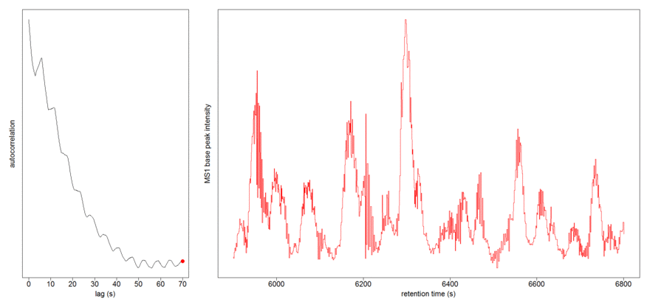
Autocorrelation-based peak width determination
Notes:
MSQC and QuaMeter emphasized quartiles for peak widths to give robust behavior in extreme variation. This is a similar mindset where we want to represent the whole gradient without being as influenced by peak shape.

Slide 12
Autocorrelation-based measure of spray stability
Shifted all points by 50 ms

Slide 13
Autocorrelation-based measure of spray stability
Shifted all points by 50 ms

Slide 14
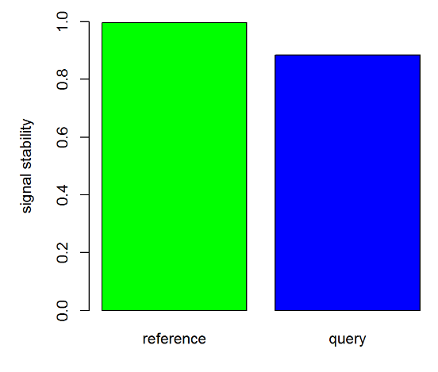
Autocorrelation-based measure of spray stability

Slide 15
Peak capacity and MS2 rate and # PSM
Notes:
I realize these aren’t related but together they are pretty informative

Slide 16
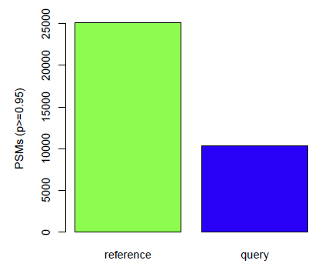
Example of a performance threshold – PSMs
Good
Marginal
Bad
Thresholds are based on instrument and type of acquisition
Since each instrument is unique, qualitative thresholds may not be applicable, but metrics are still valid

Slide 17
QC Benchmarker Implementation – Focus on automation and speed
Pre-run on server
Thermo
Agilent
Bruker
Sciex
Shimadzu
UIMF
drag and drop to website
200 ng HeLa
standard LC
standard MS/MS
query
Mass Spec?
reference
msconvert
msconvert
mzML
QC Material?
mzML
SpectraST search
PeptideProphet
comet
PeptideProphet
SpectraST -C create library
ID-free metrics
ID-based metrics
ID-free metrics
ID-based metrics

Slide 18
Summary
Commercial digests:
Used more than 70 HeLa runs to evaluate LC and MS/MS performance
Website:
Containerized Linux OS with R, Python, Redis and Celery
TPP (wine) used for identifications
Existing R packages: mzR, MSnbase, pepXMLTab
Reporting:
Pipeline generates a high-level graphic summary and a detailed report
Allows way to communicate across labs and to users what system performance is prior to running

Slide 19
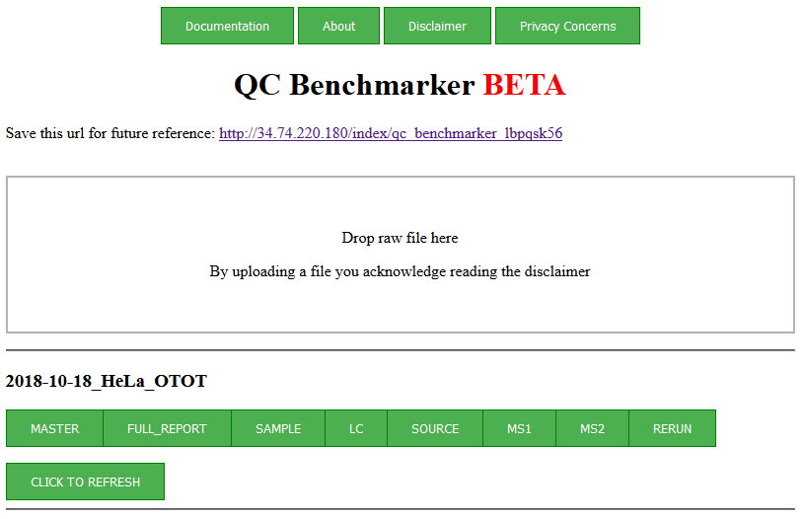
Short video demo

Slide 20
Current limitations of beta release
Do not have confirmed MS/MS methods for other platforms
Haven’t completed summary statistics and figures related to more “classic” quality measures
Notes:
The current beta supports a HeLa run on a 130 minute gradient on Lumos and QE classic.

Slide 21
Ongoing development (v1)
Test on non-Thermo platforms
Generate data and test for Water’s E. coli and Promega Yeast
please recommend any commercially available digest
Establish relevant thresholds per platform
Allow for shorter gradients or different loading amounts
Model column heater effects
Future development (v2)
Allow user to specify thresholds
Allow user to import specific reference file (ex. experiment specific conditions and QC)
Locally evaluate temporal variations on large data sets
Evaluate mass spec-based metabolomics data

